Slide 1
Shashane Welgama
Lockpicking your SQL Engine

Slide 2
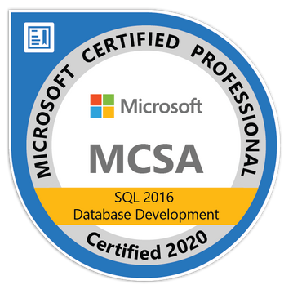
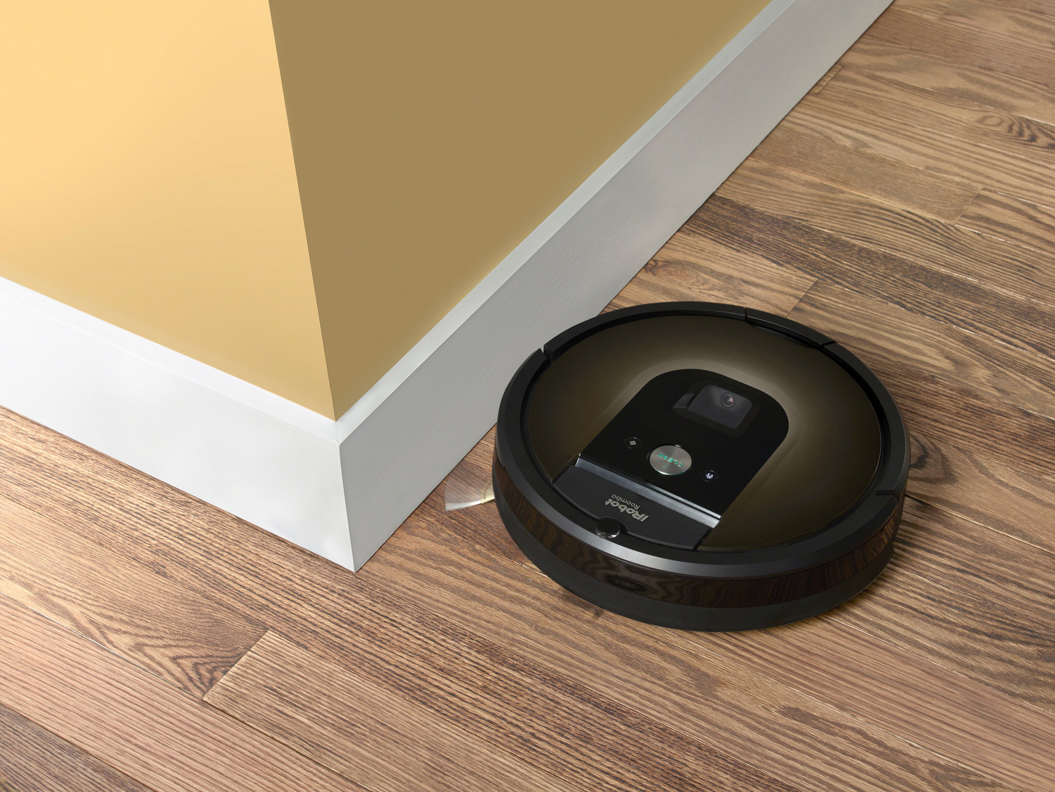
A little about me
Data Engineer at i2iLogic
Background in Database Administration
Before working in tech I used to be an iRobot Salesman

Slide 3

What we will be going through
General Idea of Locking
ACID Compliance
Locking Granularities
Locking Modes
Lock Compatibility
Lock Escalation
Controlling Lock Escalation
Deadlock Analysis Tools
Application Considerations

Slide 4
General Idea of Locking ACID Compliance

Slide 5
General Idea of Locking
Locking is essential to manage successful transaction processing.
Great for managing concurrency in a multi-user environment.
Locks are in-memory structures. That are 96 bytes in size.
Locking is designed to uphold data integrity. In turn it allows SQL Server to be ACID compliant.

Slide 6
What is ACID Compliance?
Atomicity - All or nothing. A transaction that involves several data modifications, either they all are committed or nothing is committed.
Consistency - Requires that a transaction must create a valid state of data.
Isolation - This means that a transaction that is still running and did not commit all the data yet, this transaction must stay isolated from all other transactions.
Durability - This means that committed data is stored and the data is preserved in the correct state, even in case of a failure.

Slide 7



General Idea of Locking
Reads
Reads
Jan
Jason

Slide 8
General Idea of Locking
Writes
Jan
Jason

Slide 9
General Idea of Locking
Reads
Writes
Jan
Jason

Slide 10
Locking Granualities

Slide 11
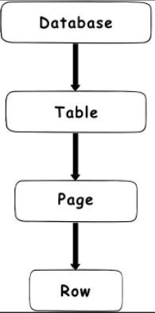
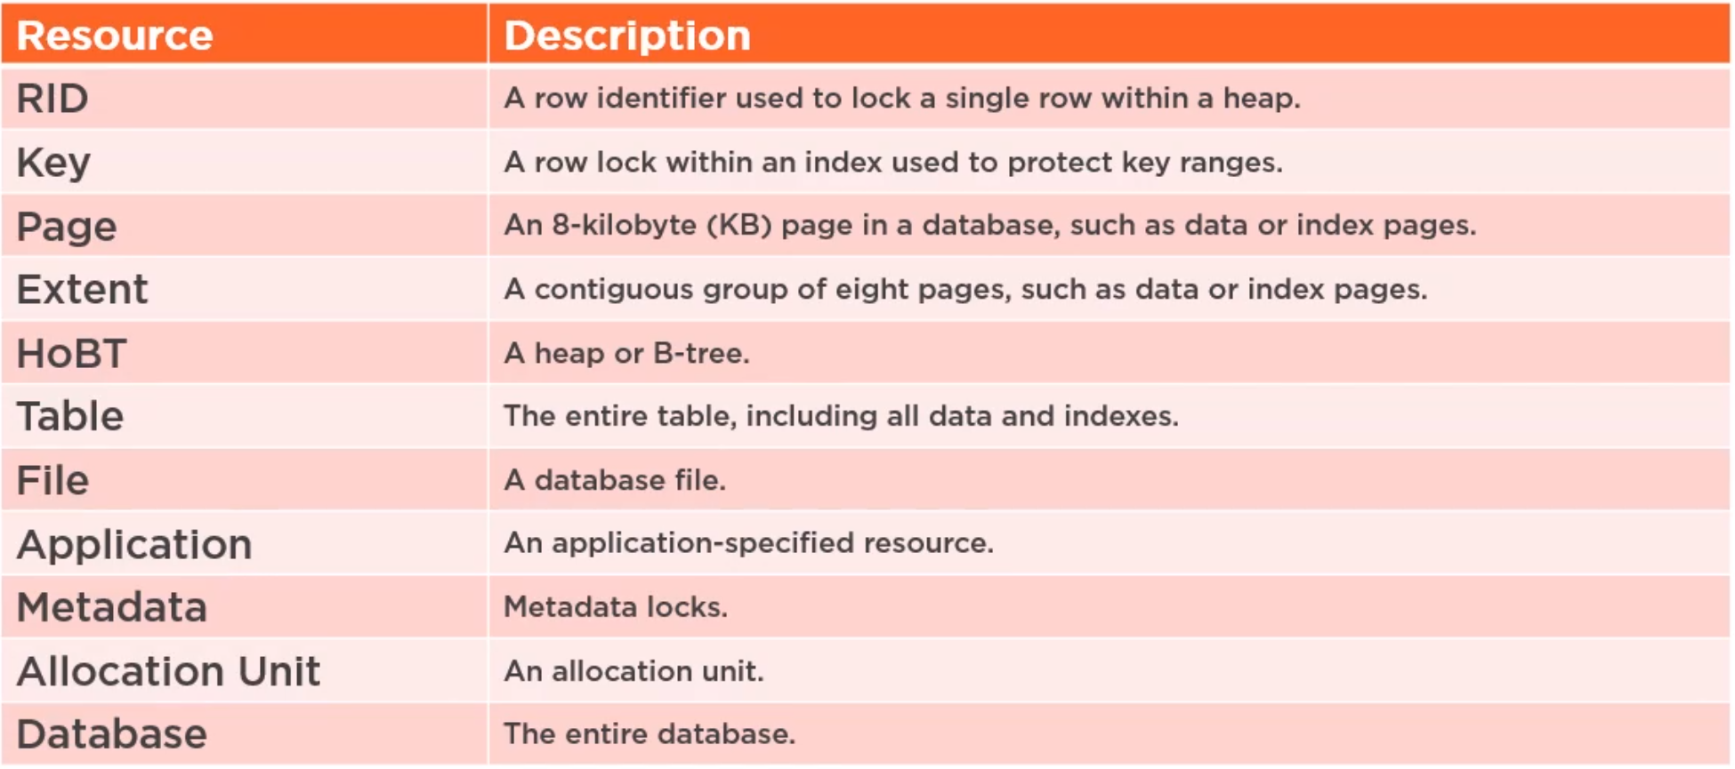
Locking Granularities

Slide 12
Locking Modes

Slide 13
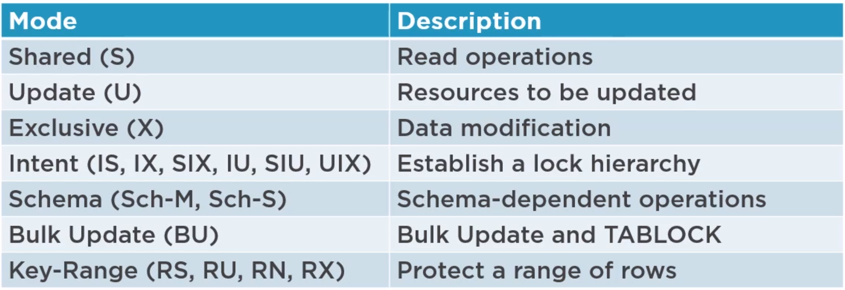
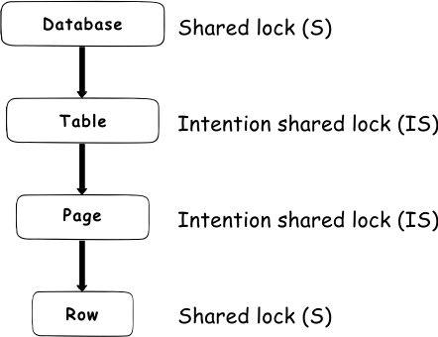
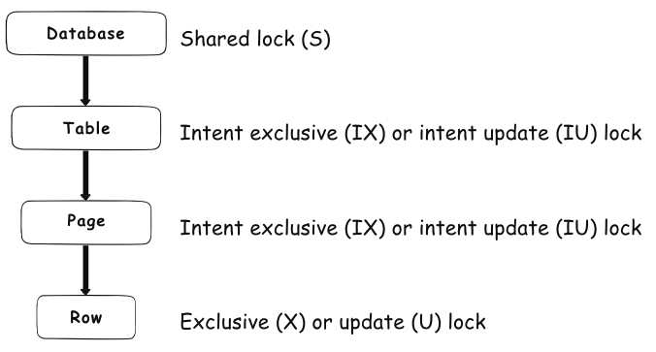
Locking Modes
Shared lock (S) - this lock will reserve a page or row only for reading.
Update lock (U) - this lock will reserve a resource in need to be updated. Once the transaction is ready to update the data, the update lock will turn into an exclusive lock.
Intent locks (I) - this lock means that a transaction intends to acquire a lock on a lower level on the lock hierarchy. An intent lock will not allow exclusive locks to be placed on them.

Slide 14
DEMO

Slide 15
Regular Intent Locks
Intent exclusive (IX) - this lock tells SQL Server that the transaction has the intention to modify lower hierarchy resources by getting exclusive (X) locks.
Intent shared lock (IS) - this lock tells SQL Server that the transaction has the intention to read lower hierarchy resources by getting shared (S) locks.
Intent update locks (IU) - this lock tells SQL Server that the transaction has the intention to update lower hierarchy resources by getting update (U) locks.

Slide 16
Conversion Locks
Shared with intent exclusive (SIX) - this lock indicates that a transaction intends to read ALL resources at a lower hierarchy and some of those resources will have IX locks to modify even lower hierarchy resources.
Shared with intent update (SIU) - this lock indicates that a transaction intends to read ALL resources at a lower hierarchy and some of those resources will have IU locks to modify even lower hierarchy resources.
Update with intent exclusive (UIX) - when update lock (U) and intent exclusive (IX) locks are acquired at lower hierarchy resources in the table simultaneously, the update with intent exclusive lock will be acquired at the table level as a consequence

Slide 17
Locking Compatibility

Slide 18
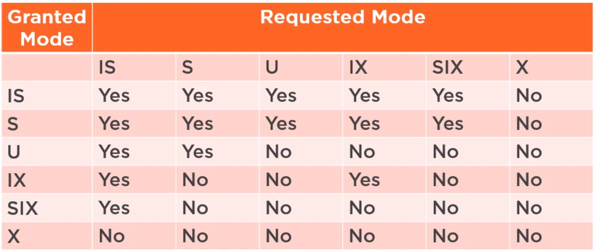
Lock Compatibility
Incoming Lock
Current Lock on Resource

Slide 19
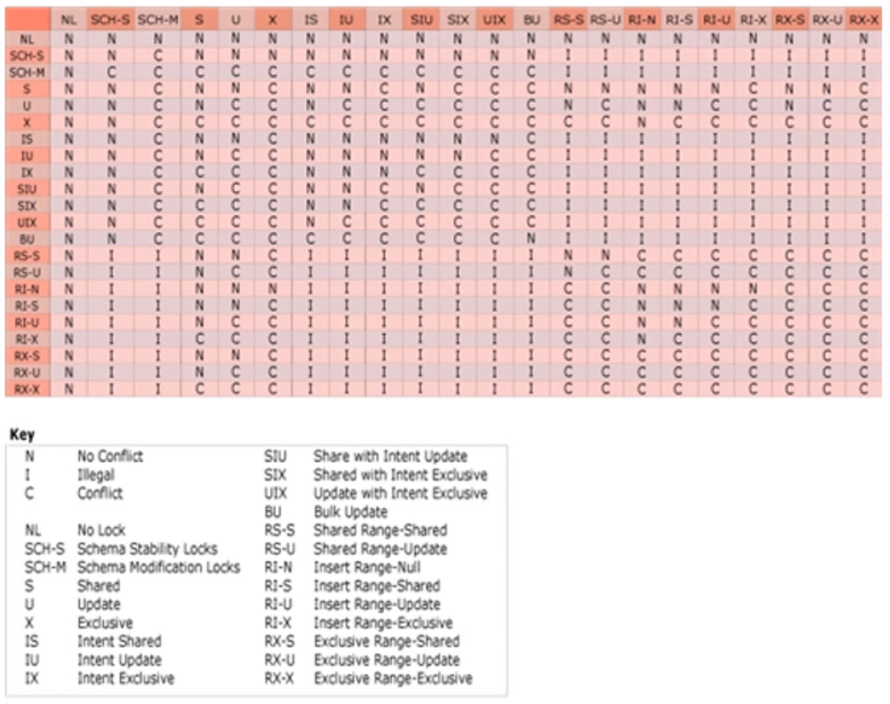

Slide 20
Lock Escalation

Slide 21
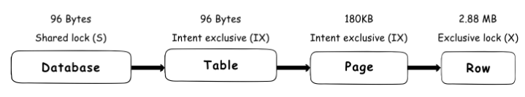
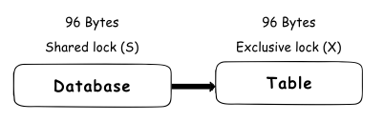
Lock Escalation
In order to prevent the situation of locking using too many resources, SQL Server has a built-in lock escalation feature.

Slide 22
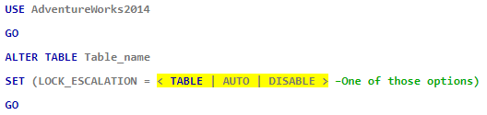
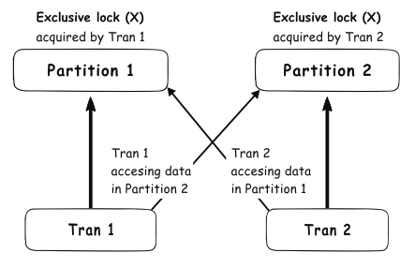
Controlling Lock Escalation

Slide 23
DEMO

Slide 24
Deadlocks

Slide 25
Deadlock Analysis Tools
Extended Events
SQL Server Management Studio (SSMS)

Slide 26
DEMO

Slide 27
Application Considerations

Slide 28
Application Considerations
Handle Deadlocks
Discuss which deadlock victim should fail
OR
Retry the operation to try and get it to work
Avoid Deadlocks
Keep transactions short
OR
DEADLOCK_PRIORITY - you can use this to tell SQL Server if the transaction should NOT be a deadlock victim

Slide 29
Thanks for Listening!
Resources for Further Learning
Twitter: @ShaneWelgama Blog: https://shanewelgama.com/ Email: shashanewelgama@gmail.com
Managing SQL Server Database Concurrency By Gerald Britton
All about Locking in SQL Server - SQL Shack

Slide 30
Lockpicking your SQL Engine
Shashane Welgama

